Slide 1
HTTP Methods
By: Darrin McIntyre

Slide 2
Important Descriptors
Methods can also have the property of "idempotence" in that (aside from error or expiration issues) the side-effects of N > 0 identical requests is the same as for a single request.
Idempotence is not enforced by the protocol/web server.
A method is safe is a HTTP method that does not modify resources and should not change the state of the server.
A method is cacheable if its response can be stored for later use.
Why is this important?
EX: Client wanting to update a resource through POST.
- Lots of questions to answer
- Idempotence removes the need to ask.

Slide 3
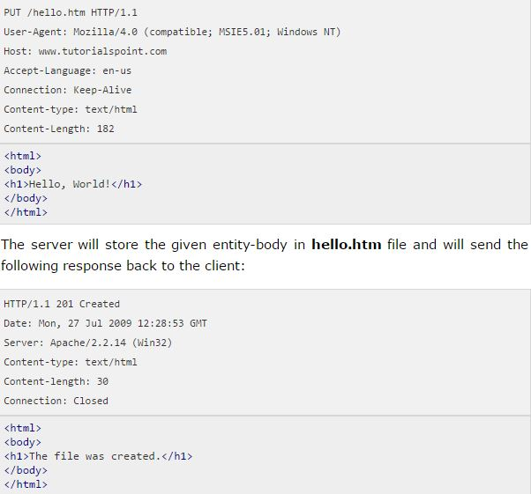
PUT
Idempotent: Yes
Safe: No
Cacheable: No
Creates a new resource or replaces a representation of the target resource with the request payload.
Responses: 201 (Created)

Slide 4
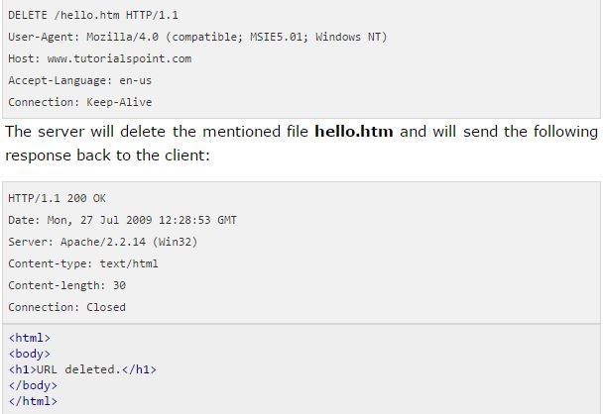
DELETE
Idempotent: Yes
Safe: No
Cacheable: No
Used to delete the specified resource.
Server should not indicate success unless at the time response is given it intends to delete the resource or move it to an inaccessible location.
Responses: 200 (OK), 202 (Accepted), 204 (No Content)

Slide 5

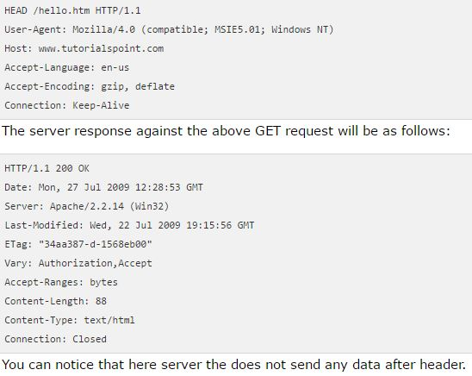
HEAD
Idempotent: Yes
Safe: Yes
Cacheable: Yes
Requests the headers that are returned if the specified resource would be requested with an http GET method.

Slide 6
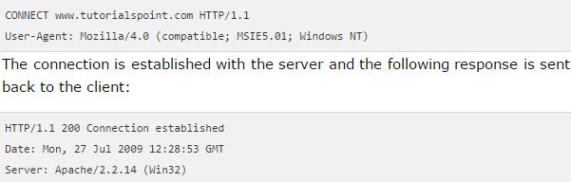
Connect
Idempotent: No
Safe: No
Cacheable: No
Starts two-way communications with the requested resource. It can be used to open a tunnel.

Slide 7
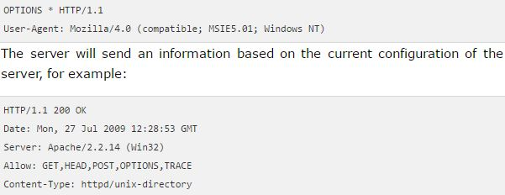
OPTIONS
Idempotent: Yes
Safe: Yes
Cacheable: No
Used to describe the communication options for the target resource.
Max-Forwards request-header field may be used to target a specific proxy in the request chain.

Slide 8
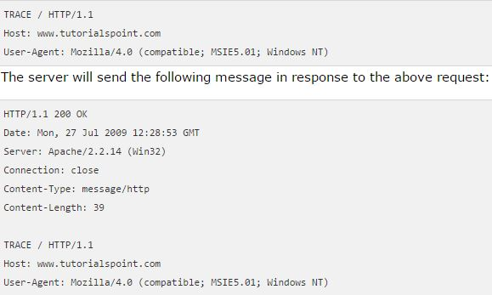
TRACE
Idempotent: Yes
Safe: Yes
Cacheable: No
Used to invoke a remote application-layer loop-back of the request message. The final recipient of the request should reflect the message received back to the client as the entity-body of an OK response (200).
The final recipient is either the origin server or the first proxy or gateway to receive a Max-Forwards value of zero in the request.

Slide 9

References
http://restcookbook.com/HTTP%20Methods/idempotency/
https://www.w3.org/Protocols/rfc2616/rfc2616-sec9.html
https://developer.mozilla.org/en-US/docs/Web/HTTP/Methods/OPTIONS
https://www.tutorialspoint.com/http/http_methods.htm

